Slide 1
Hello!
I’m Cameron

Slide 2
Force Training
Salesforce Project

Slide 3

THE Format
- Consultant Journey - Live Demo - Project overview - Questions

Slide 4
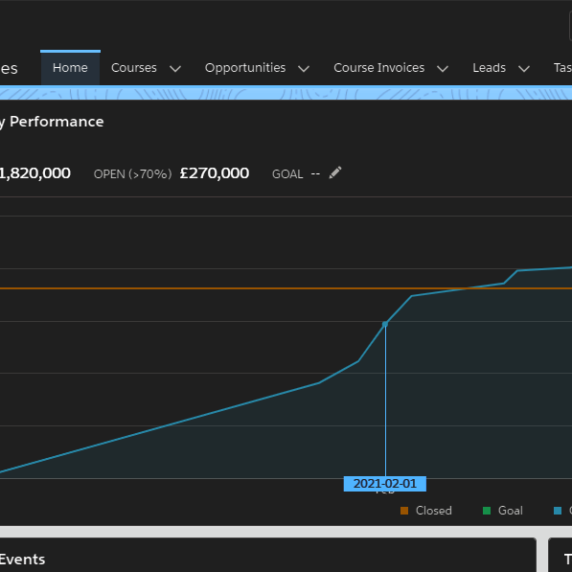
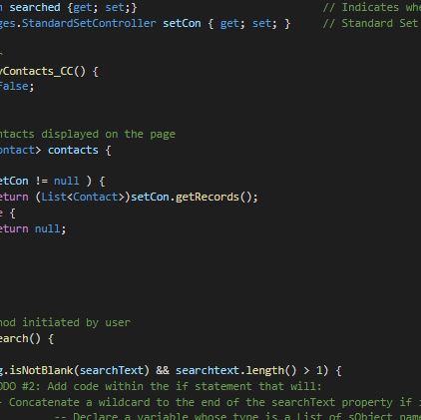
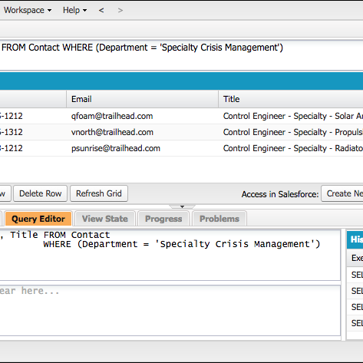
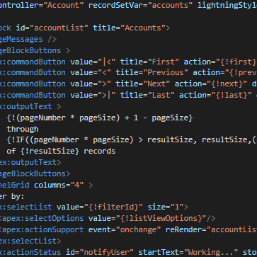
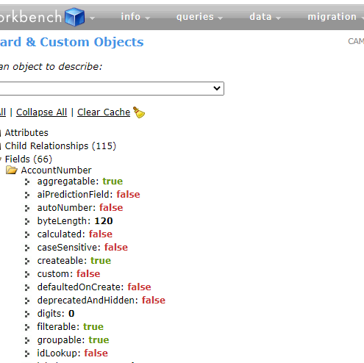
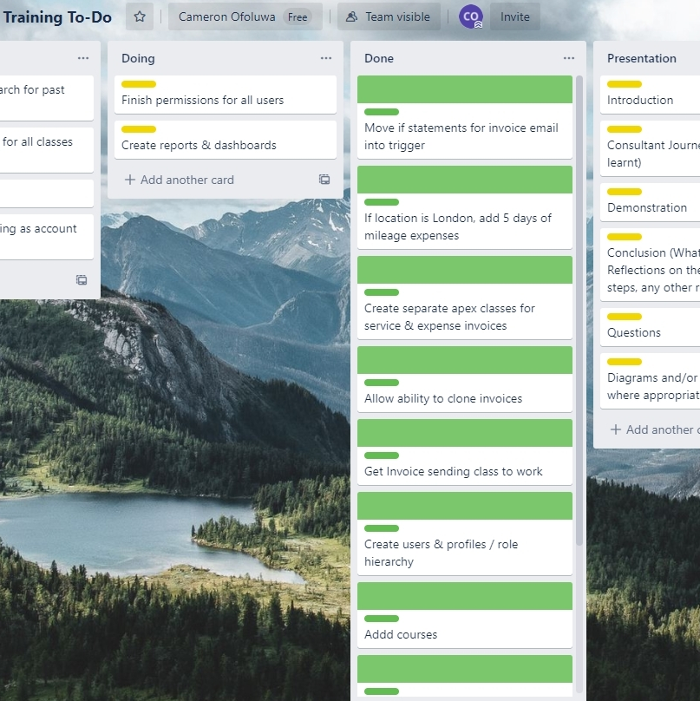
Consultant Journey
What have I learnt - Salesforce & Lightning UI - SF Declarative Software - Apex & Testing - SOQL & SOSL - VisualForce Pages - Workbench - Trello
Lightning UI
APEX
SOQL / SOSL
Visualforce
Workbench
Trello

Slide 5
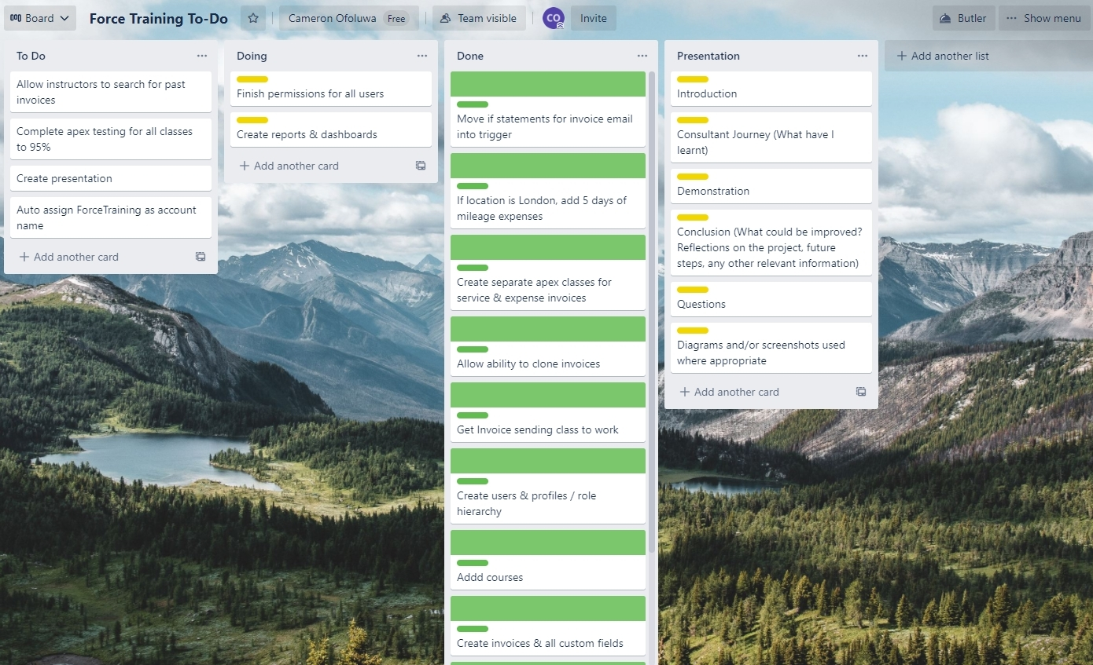
Consultant Journey

Slide 6
Live Demo
STEP 01
Create a new course opportunity in London and then check my calendar and notifications
Change the course opportunity stage to complete and check a service invoice has been automatically created
STEP 03
Create an expense invoice showing mileage automation and then attempt to clone this invoice.
STEP 02
STEP 04
STEP 05
Change invoice status to submitted, firstly trying to throw and error then succeeding. Then check the billing admin’s email
Go over reports & dashboards and then end the live demo

Slide 7
Project overview
What Went Well
Compared to the last project, I feel as though I approached the project and more maturely and instead of just jumping in, I sat back and understood the requirements and created a plan of action instead of aimlessly jumping in headfirst.
What Could be Improved If I could go back, I would work on my own cloning system for cloning invoices as I'm not 100% happy with it and I would 100% work on redesigning the invoice PDFs as they aren’t the most visually pleasing. There are a few other changes I’d like to make to make the whole process seem cleaner.

Slide 8
Project overview
Future Steps If I were to continue working on the project, like I mentioned earlier I would change how I go about cloning invoices as I don’t think the UI is the cleanest and there is some missing functionality where not important, would make people’s life easier such as changing the dates in the clone UI.
I also need to carry out all the testing to a total coverage of around 95%.

Slide 9
Thank you!
Any questions?

